Slide 1
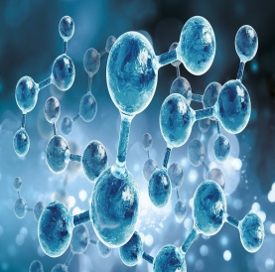
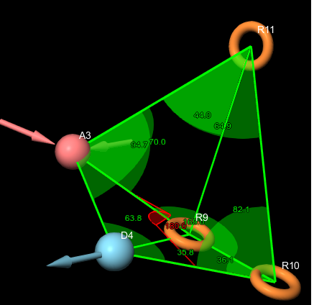
Pharmacophore model ADRRR1
interstice angles in (°) unit between
the pharmacophoric points

