Slide 1
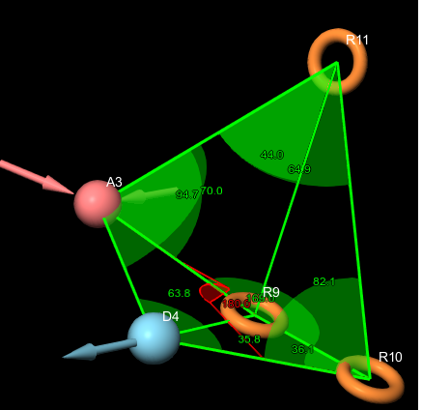

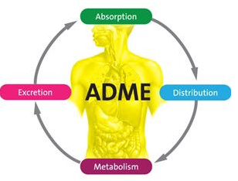
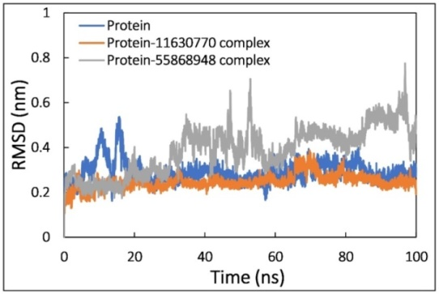
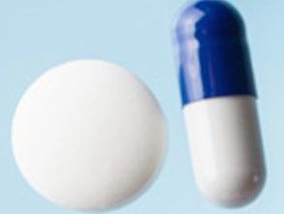
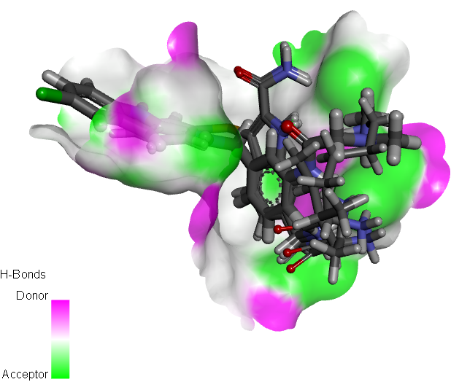
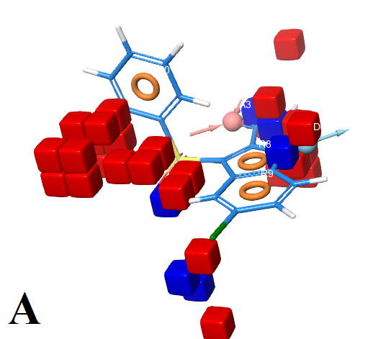
basic structure of indolyl-aryl-sulfones.
pharmacophore model
3D-QSAR model
virtual screening
Docking simulations
ADMET properties
Inhibitor of HIV protease enzyme
Molecular Dynamics
drug-like candidates

