Slide 1
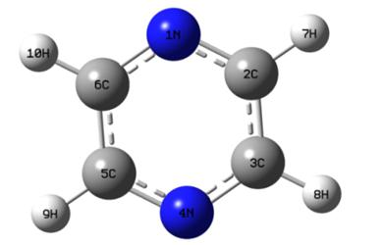
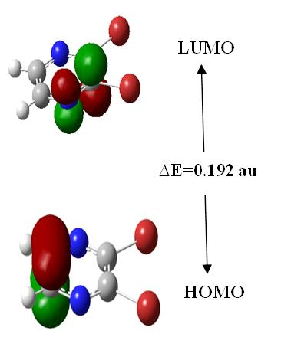
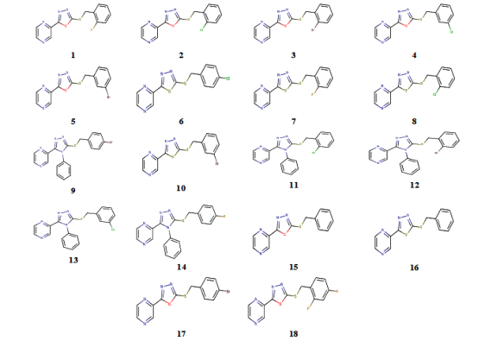
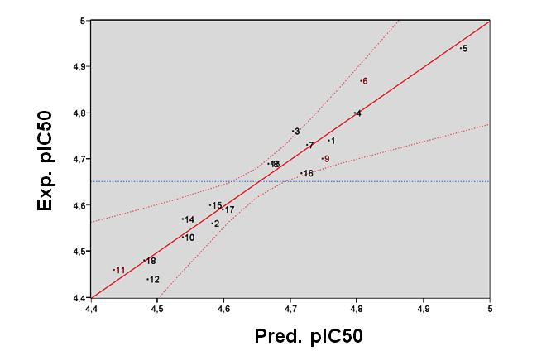

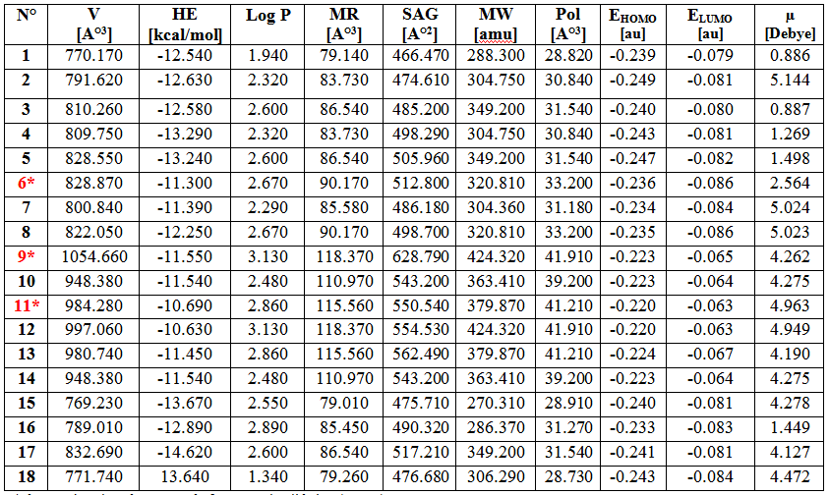
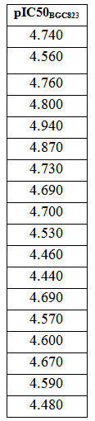

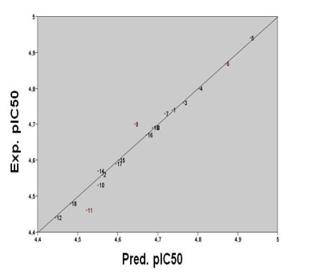


Geometric and electronic structure
Substitution effect
Chemical Library of pyrazines
SAR
Drug-likeness
Calculation of molecular descriptors
Data set
(training set +test set)
MLR
Internal and external validation of QSAR models
QSAR Model
ANN
Molecular descriptors
Activities

