Slide 1
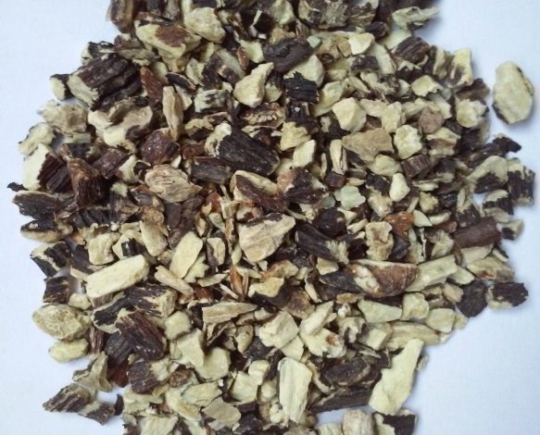
Comfrey root
TRADITIONAL TECHNOLOGIES
vs.
CONTEMPORARY TECHNOLOGIES
Maceration
Polyphenolic content
Antioxidative activity
ACE inhibition activity
Antiproliferative activity
Ultrasound-assisted extraction
Subcritical water extraction
Process optimization

