Slide 1
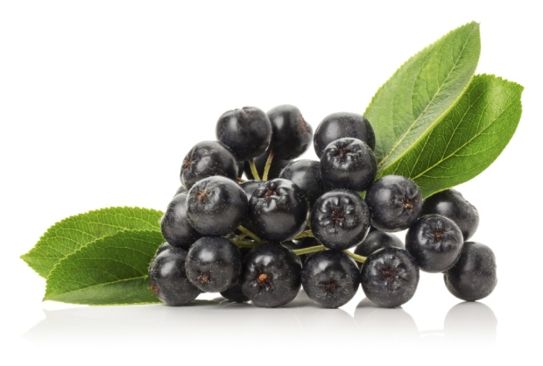
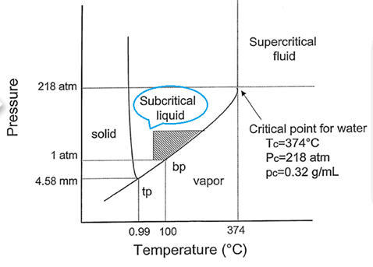





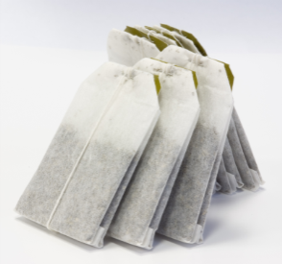

Recycled product:
SWE extract with
high concentration of polyphenolic compounds
Drying
Analyzed:
Total phenolics content
Total flavonoids content
Anthocyanins content
Antioxidant activity
Storage
Subcritical water extraction (SWE)
Cutting
FITLER-TEA FACTORY
At different temperature (120-200°C)
At different time (15-35 min)
Adding different HCL concentrations (0-1.5%)
Grinding
Vibro sifting
Fraction collecting
By-product
d < 0.315 mm
Box-Behnken design
Storage of adequate particle size material
…
Packaging
‘
Aronia fruit filter-tea

